Slide 1




Friday, March 9th 2018
Cervical amplitudes recording with a virtual reality device
Florian Garibal
Guillaume Hottin
Quentin Jaubertie
Luc Sapin
François-Xavier Stempfel
Notes:
GUILLAUME
Next => QUENTIN : Team Overview

Slide 2

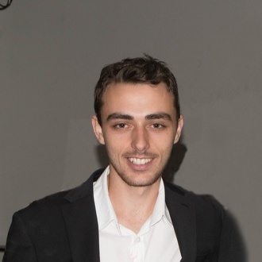
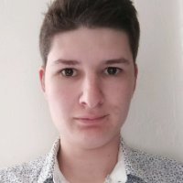
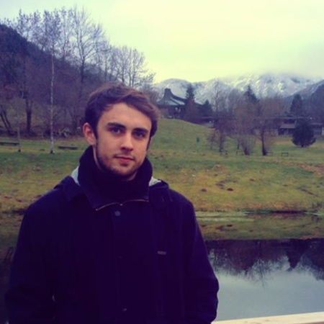
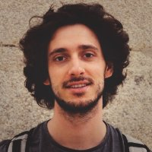
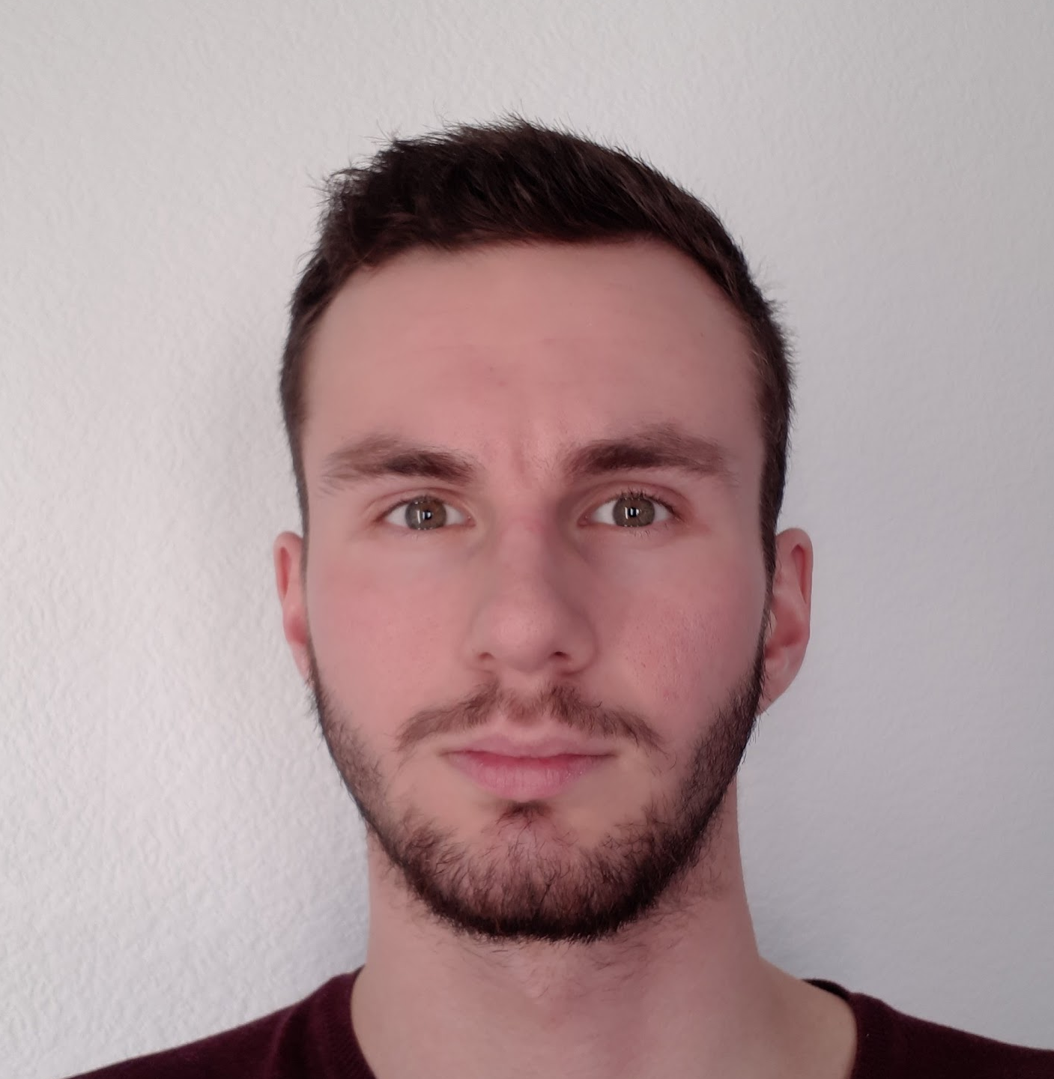
Team Overview
Florian
Garibal
Guillaume
Hottin
Quentin
Jaubertie
Luc
Sapin
François Xavier
Stempfel
Software specialty
HPC Big data specialty
Notes:
QUENTIN
In our groupe, we have two main specialties
-> flo/gui : software specialty : specialized in computer science/interface development
-> fx/luc/quentin : applied mathematics field: specialized in modelling and data analysis
Next => GUILLAUME : Introduction

Slide 3
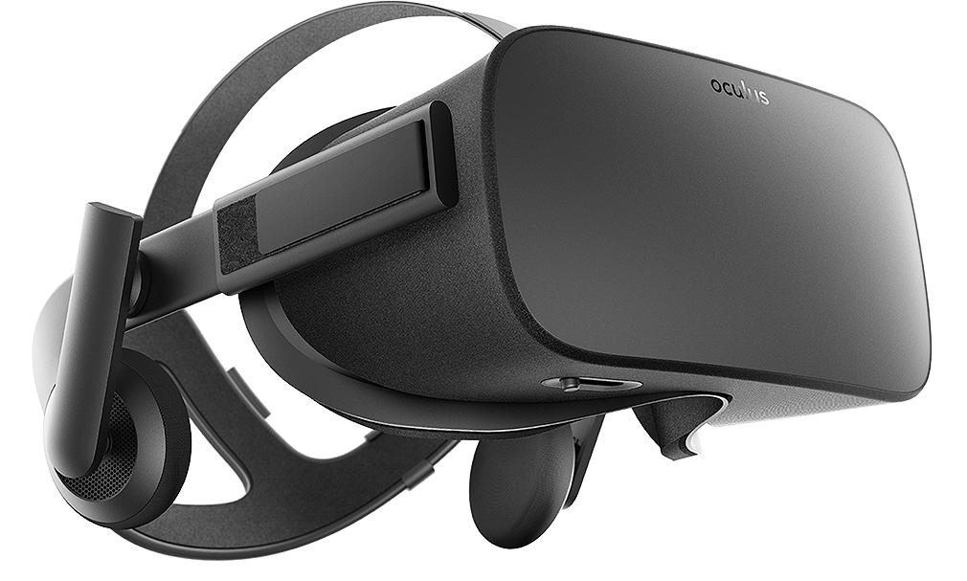
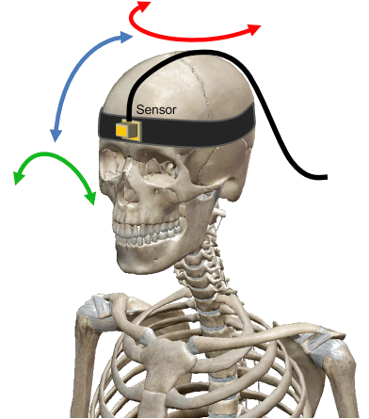
Introduction
Last year project
Duration: 7 weeks
Oculus Rift headset to acquire data
Will be used by osteopaths to
determine if a patient is healthy
Yaw
Pitch
Roll
Notes:
GUILLAUME

Slide 4
Outline
GUI and 3D part
Math/Data Analysis
Project management
Notes:
GUILLAUME
Next => LUC : Last year’s project

Slide 5
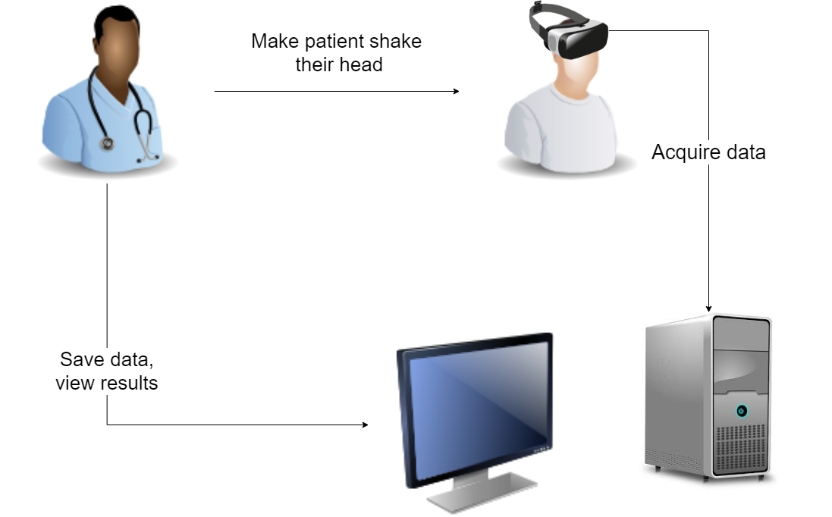
Last year’s project overview
Notes:
LUC

Slide 6
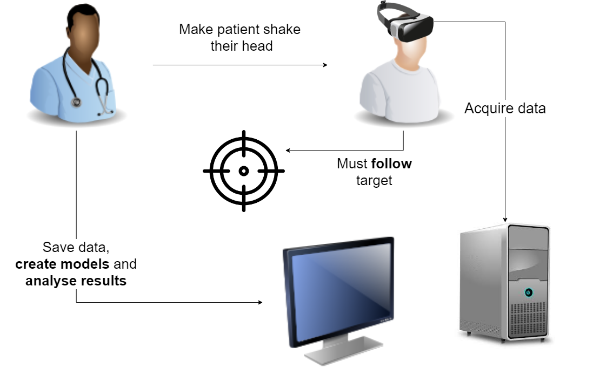
Specifications
Notes:
LUC
Next => FLORIAN : Architecture

Slide 7
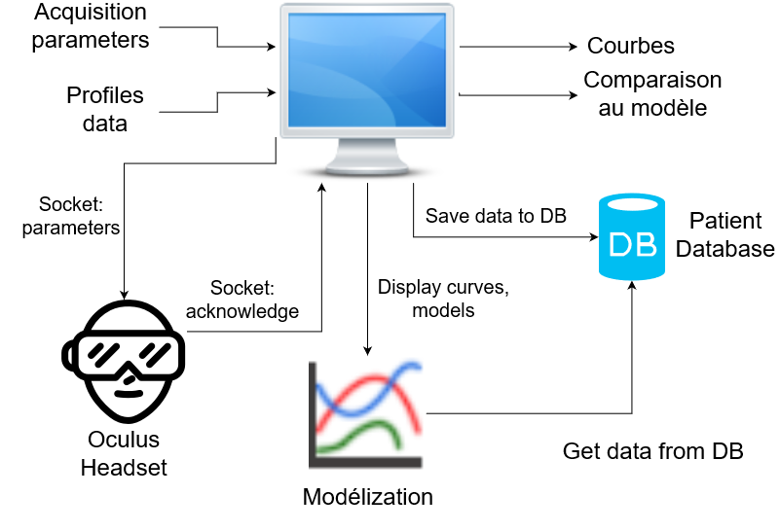
Overall architecture
Acquisition
parameters
Curves
Comparison with model
Profiles data
Socket: Parameters
Display model curves
Socket: Acknowledge
Get model data
from DB
Modeling
Notes:
FLORIAN
Next => FRANÇOIS-XAVIER : Constraints

Slide 8
Constraints
Only one Oculus Rift headset available
Forced to go to the Osteopathy Institute of Toulouse to test
Only one of our PCs could run the Oculus Rift headset
Software must run on Windows
Use last year’s project:
C++ language
Use data previously acquired to create models
Notes:
FX
NEXT: FLORIAN & GUILLAUME => GUI AND 3D

Slide 9
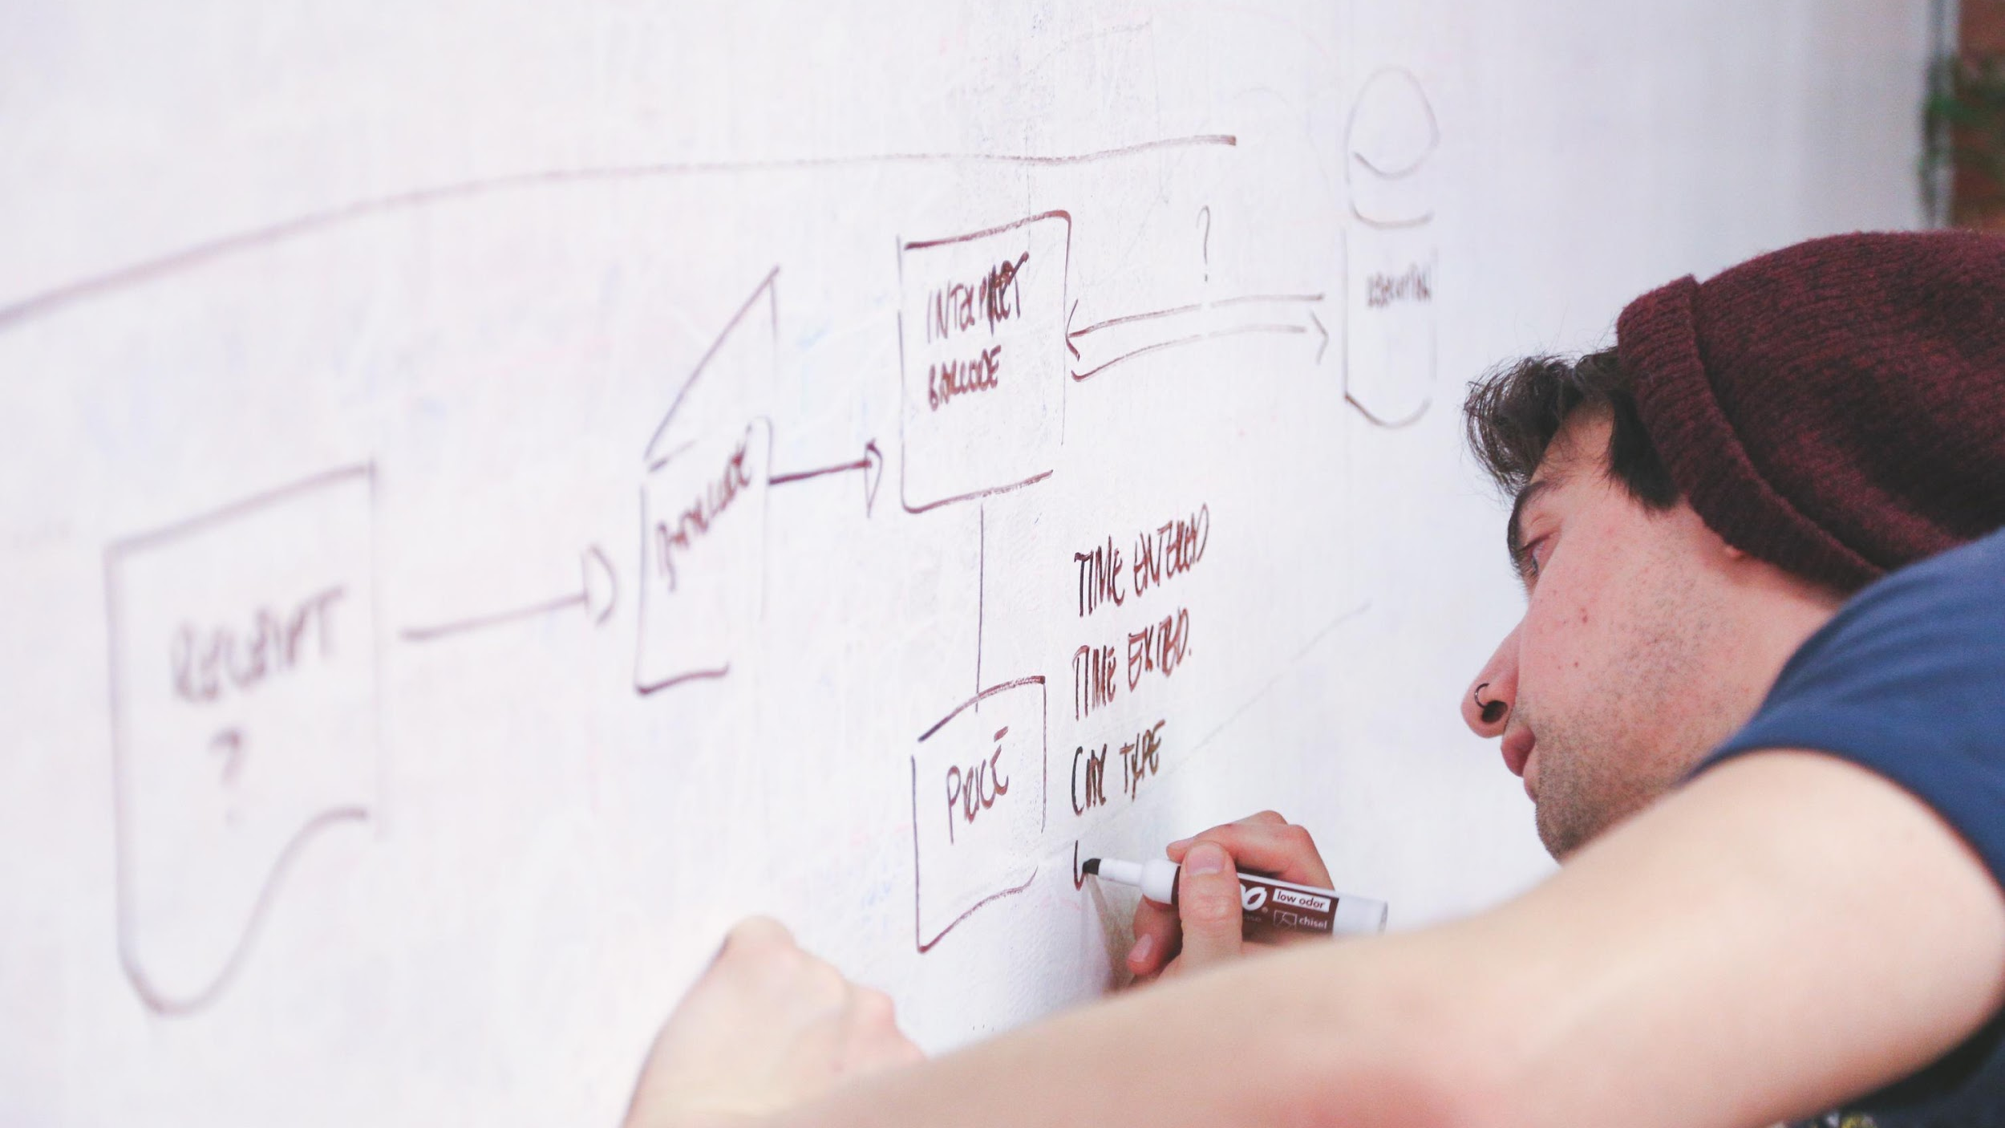
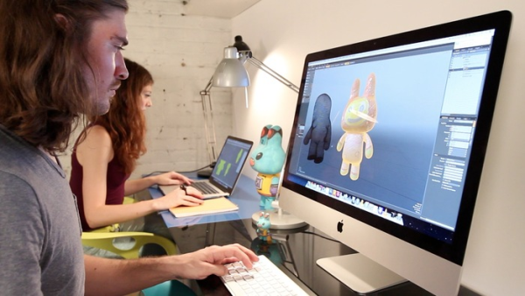
GUI and 3D part
Notes:
GUILLAUME

Slide 10
Three major parts
Design the Oculus Rift tracker
Adapt the GUI to specify parameters
Connect both apps
Display a tracker
Move the tracker according to parameters
Allow osteopath to set up the acquisition parameters
Send parameters through sockets
Interpret them and adapt acquisition
Notes:
GUILLAUME
Next => FLORIAN : Why display tracker ?

Slide 11
Why display a tracker ?
Problem:
Movements not normalized
Movement speed, amplitude and return number different between patient
Acquisition artefacts when angle around 90°
Solution:
Force patient to follow a tracker visually
Change the acquisition process
Set the speed and amplitude through parameters
Notes:
FLORIAN
Next => GUILLAUME : Oculus Tracker

Slide 12
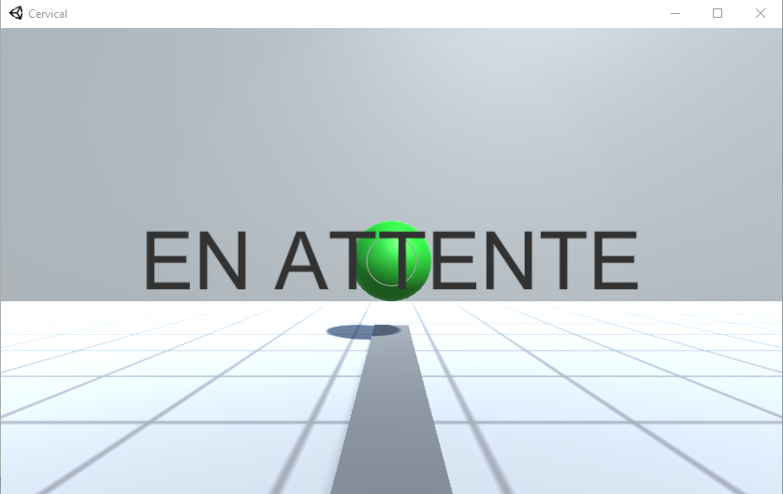
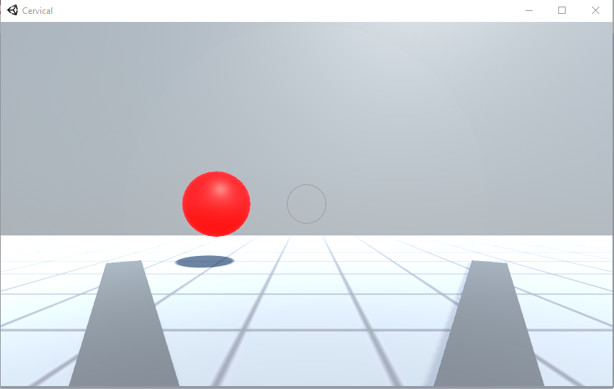
Oculus tracker
Waiting for an acquisition
Acquisition running
Notes:
GUILLAUME

Slide 13

Oculus tracker
Unity 3D framework
Easy to design the scene (drag and drop)
Available tracker parameters:
Speed
Maximum angle
Wait time at extremums
Number of “come and go”, returns
Scripting in C#, easy to understand
Notes:
GUILLAUME
Next => FLORIAN : Adapt GUI

Slide 14

Adapt the GUI
Last year project:
Not enough documentation
Not well structured to receive improvements
Choices:
No more constraint on language
Redesign the architecture
Use Python and PyQt library
Match mathematical modeling language
Notes:
FLORIAN

Slide 15
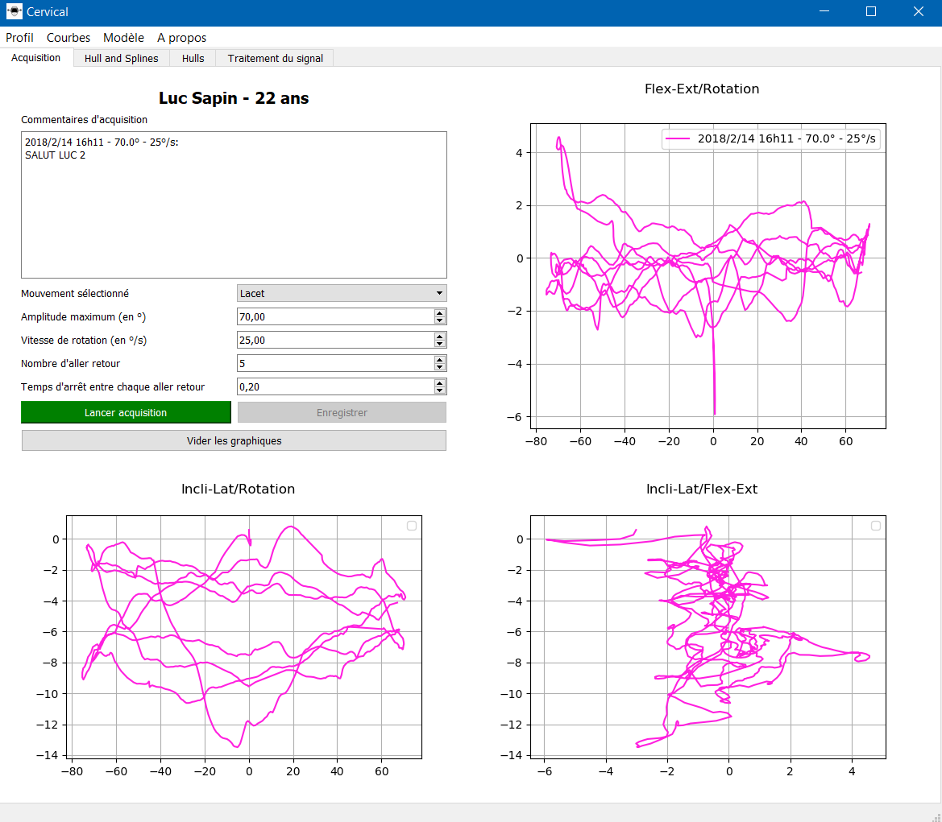
GUI
Add a menu bar to perform profiles, curves and models management
Add inputs for acquisition parameters
Validate the design with osteopath
Notes:
FLORIAN
Next => FRANÇOIS-XAVIER : Data ANALYSIS

Slide 16
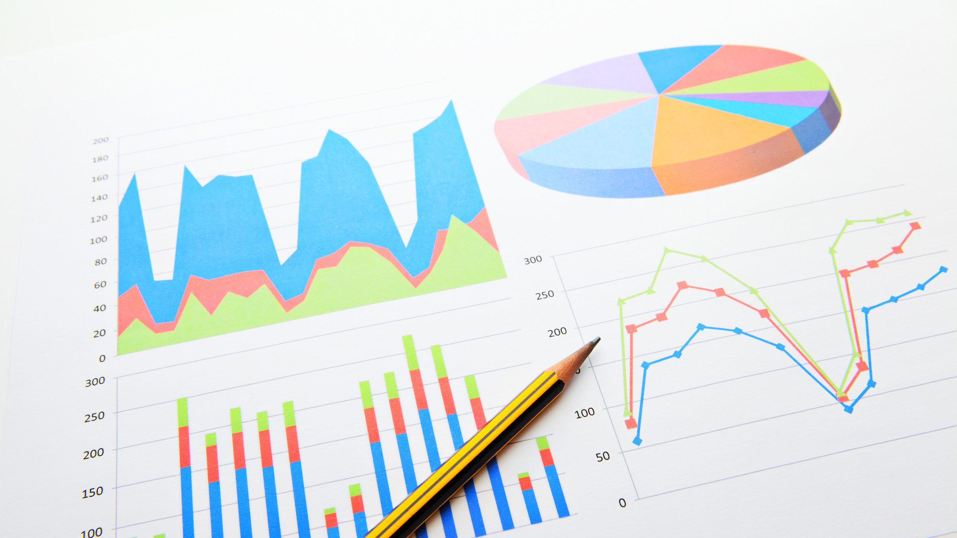
Data Analysis
Notes:
FX
main purpose => predict whether a patient is healthy or not
to do that => use data analysis and thus mathematical tools

Slide 17
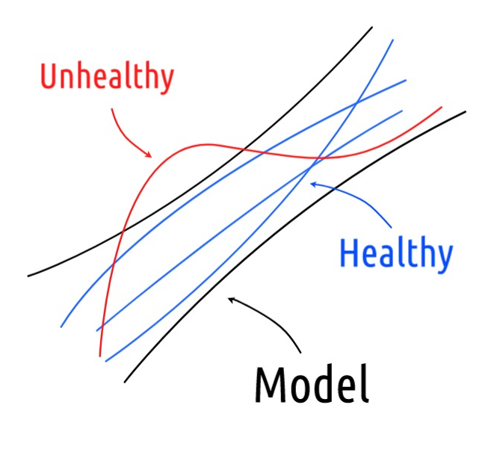
Modeling
Data acquired last year
But acquisition was incorrect
Spot and fix acquisition issues
Build a new data set, well-structured
Issue: lack of data
Notes:
FX
NEXT: LUC => TIME SERIES
First of all I will give you some insight about modeling. So, what’s a model? Here you have the representation of a general model, not one of our own but just to explain you what it is.
We build a model using a data set made of data previously acquired, here it’s in black. Then when we have new pieces of data we check whether they fit within the model, if they do we judge them to be healthy and otherwise unhealthy.

Slide 18
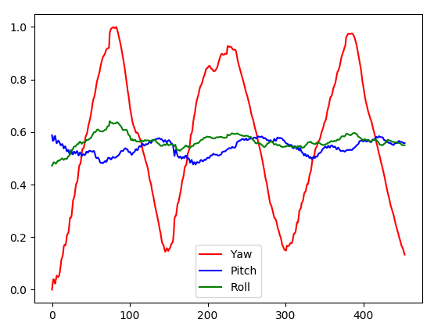
Time-based Models
Signal Processing (Time profile, Fft, Wavelet, Correlation…)
Notes:
LUC
Next => QUENTIN : ANOTHER Time-based model

Slide 19
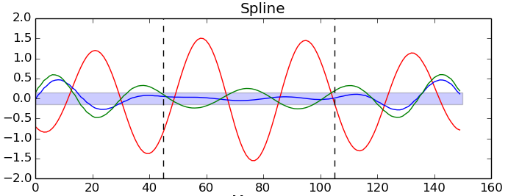
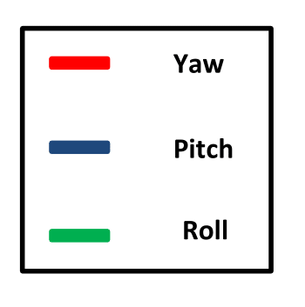
Time-based Models
Wavelets and B-Splines
Notes:
Quentin
We work on periodical motion : Wavelets tools because take care of
frequential & temporal aspect !! (diff than the last part about signal processing)
Here, Roll curve is out of rectangle in the central area -> Unhealthy
To do this, we also use B-Splines to remove all parasite motions.

Slide 20
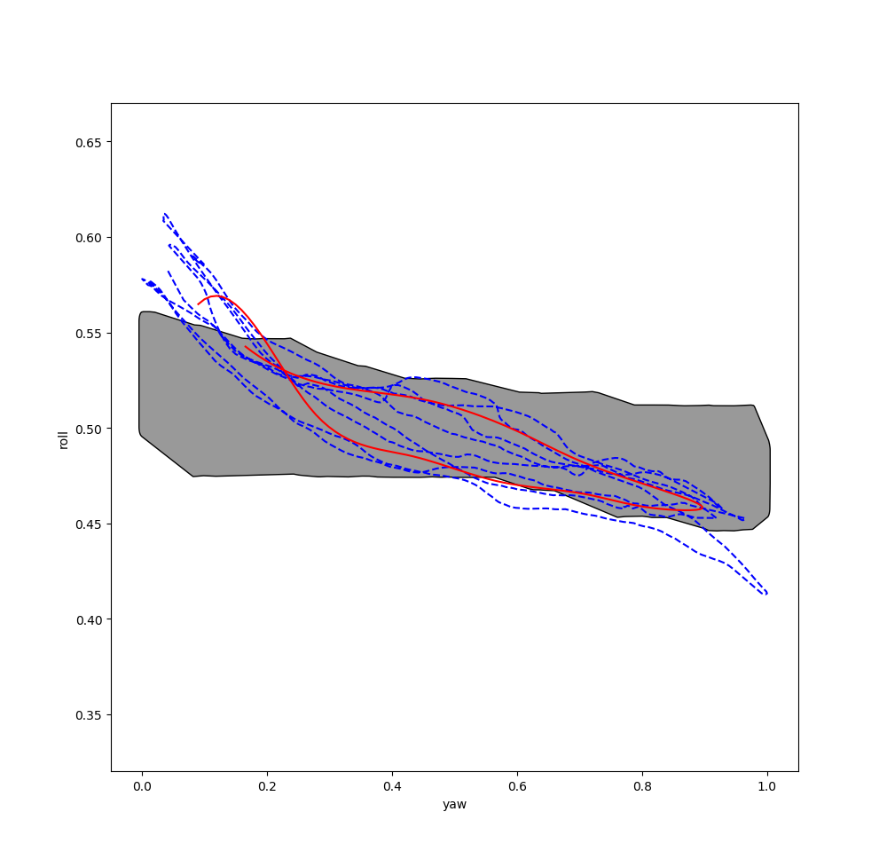
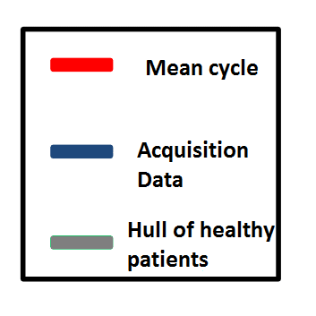
Planar Models
Projection on 1 plane:
yaw-pitch
pitch
yaw
Concave hulls and B-Splines
Notes:
Quentin
Now we no longer consider temporal models but planar models
-> Complete approach
We focus on yaw-pitch plan
hull & splines : boundaries + variability
_Boundaries : We consider all healthy patients data in the whole dataset
We compute a hull which contains all motions of healthy patient
For new acquisition data, if the motion is out the hull : Unhealthy
For this plot : out in borders !
else : Variability of motion : If the patient moved a lot his head like this (show it)
To do this : Concave hull and B-Splines tools
NEXT : FRANÇOIS-XAVIER : CLASSIFICATION

Slide 21
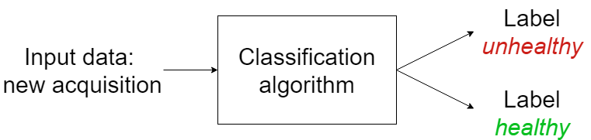
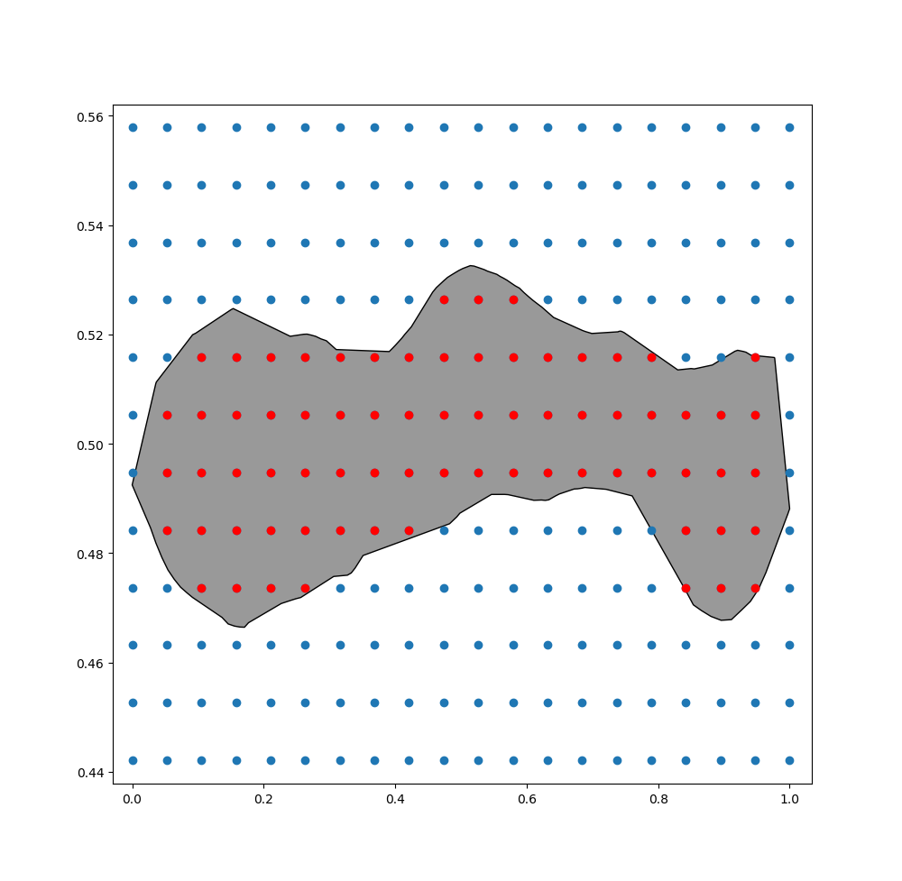
Planar Models
Classification of discrete
concave hulls
pitch
yaw
Notes:
FX
NEXT: LUC => CONCLUSION

Slide 22
Conclusion
Models need to be improved
Data acquired previously incorrect
Lack of data
Too few unhealthy patients: what’s a pathology?
Build a representative Data Set
Notes:
LUC

Slide 23
Project Management
Notes:
Luc

Slide 24
Choices
Where should we work ?
At home/N7
At the ITO Clinic if we needed the Oculus headset
Can we work separately ?
Two distinct groups made at the beginning
Each group worked separately then together to make the junction
Communicate via Internet or after the scheduled meetings to discuss some design choices and advancement of each team
Notes:
FX
NEXT: FLORIAN => MEETINGS

Slide 25

Meetings
Weekly meeting with Mr Ducommun
Explain the state of progress
Verify the consistency of our work with the client’s desires
Weekly meeting with Mr Camus
Check the running of project management
Advices and ideas of improvement
A meeting every other week with Ms Mouysset
Advice about mathematical modeling
Help about algorithm problems
Notes:
Flo

Slide 26

Quality assurance process
The software had to be tested
Test scenarios with human input for the GUI and 3D application
Small standalone software to automatically test some inputs
Reviewing the code by someone else
Each group read the other group’s code
Frequent meetings with the client to ensure it was matching his needs
Notes:
LUC

Slide 27
Risk Management
Id | Title/Description | Reason | Probability (1-5) | Consequence | Severity (1-5) | Actions
1 | Impossible to display tracker while displaying GUI | SDK Oculus Rift | 1 | Impossible to meet the client requirements | 5 | Read the Oculus documentation
2 | Data set given unusable | Poor quality of data, issues in last year’s project | 3 | Impossible to create a model from this set | 4 | Create a new data set Use another way to create the model
3 | Misunderstanding of client requirements | Lack of clarity | 2 | Impossible to meet client requirements | 5 | Do not hesitate to ask question Write specifications
4 | Difficulty in taking over last year project | Lack of comment and documentation, not well structured, language unknown | 3 | Restart the whole project OR take more time | 2 | Read the code Read the documentation Assess the amount of time it takes to restart everything
Notes:
DB GUI

Slide 28
Risk Management
Unacceptable risks
Moderate risks
Negligible risks
Impossible to display tracker while displaying GUI
Data set provided is unusable
Misunderstanding of client requirements
Difficulty in taking over last year project
5
4
3 |  | 4 |  | 2
2 |  |  |  |  | 3
1 |  |  |  |  | 1
 | 1 | 2 | 3 | 4 | 5
Probability
Severity
Notes:
FX

Slide 29
Risk Management
Unacceptable risks
Moderate risks
Negligible risks
Impossible to display tracker while displaying GUI
Data set provided is unusable
Misunderstanding of client requirements
Difficulty in taking over last year project
5
4
3 |  | 2/4
2 |  |  |  |  | 3
1 |  |  |  |  | 1
 | 1 | 2 | 3 | 4 | 5
Probability
Severity
Notes:
FX
NEXT: LUC => ROADMAP

Slide 30
Road map
Modelling
Integration with GUI
Documentation
Installation
Specifications
Planning
Analyse data
Preprocessing
Unity
Python
Display in headset
Tracker animation
Validation
Test
CW 4
CW 5-6
CW 7
CW 8
CW 9
Notes:
Luc

Slide 31

Objectives
Display a moving tracker inside the Oculus Headset
Display a crosshair to help patient to follow the tracker
Display acquisition state inside the headset (waiting, countdown, ended)
Add parameters to custom the tracker movement
Adapt the GUI to specify parameters
Restart the whole GUI design and architecture
Create one model to distinguish unhealthy patient
Display three models to help osteopath find a
discriminant point to distinguish patient
Notes:
DBGUI

Slide 32

Conclusion
Notes:
Quentin

Slide 33
Project management
Weekly meetings with the client and the industrial supervisor
Google Drive with everyone’s planning on it
Synchronize code with Github
Allocate more time for risk management and schedule
Use a project management software
Notes:
Quentin

Slide 34
Conclusion
7362
7
80%
Code lines
weeks of work
Project Achievements
Hard to deal with the uncertainty of the project
Very interesting subject
Learn new technologies
Notes:
Quentin
project works but is still in progress : Build dataset to improve and test at 100% models
human side -> discuss a lot with client to do things he want
-> discuss in the group to organize meetings, share ideas and work
subject -> Rewarding : Lot of pb but solve (for the most part)
Lot of new techno (OR), discover medicine
project is out of the ordinary but very interesting

Slide 35
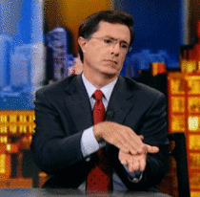
But...
One risk forgotten...
Global Oculus shutdown
Security certificates not updated
THANKS OCULUS !
Notes:
Flo

Slide 36
Any Questions?

Slide 37
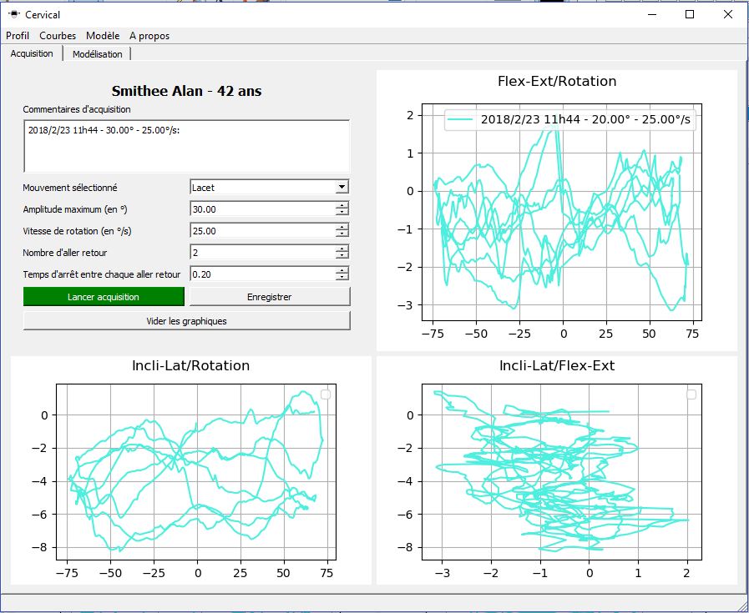
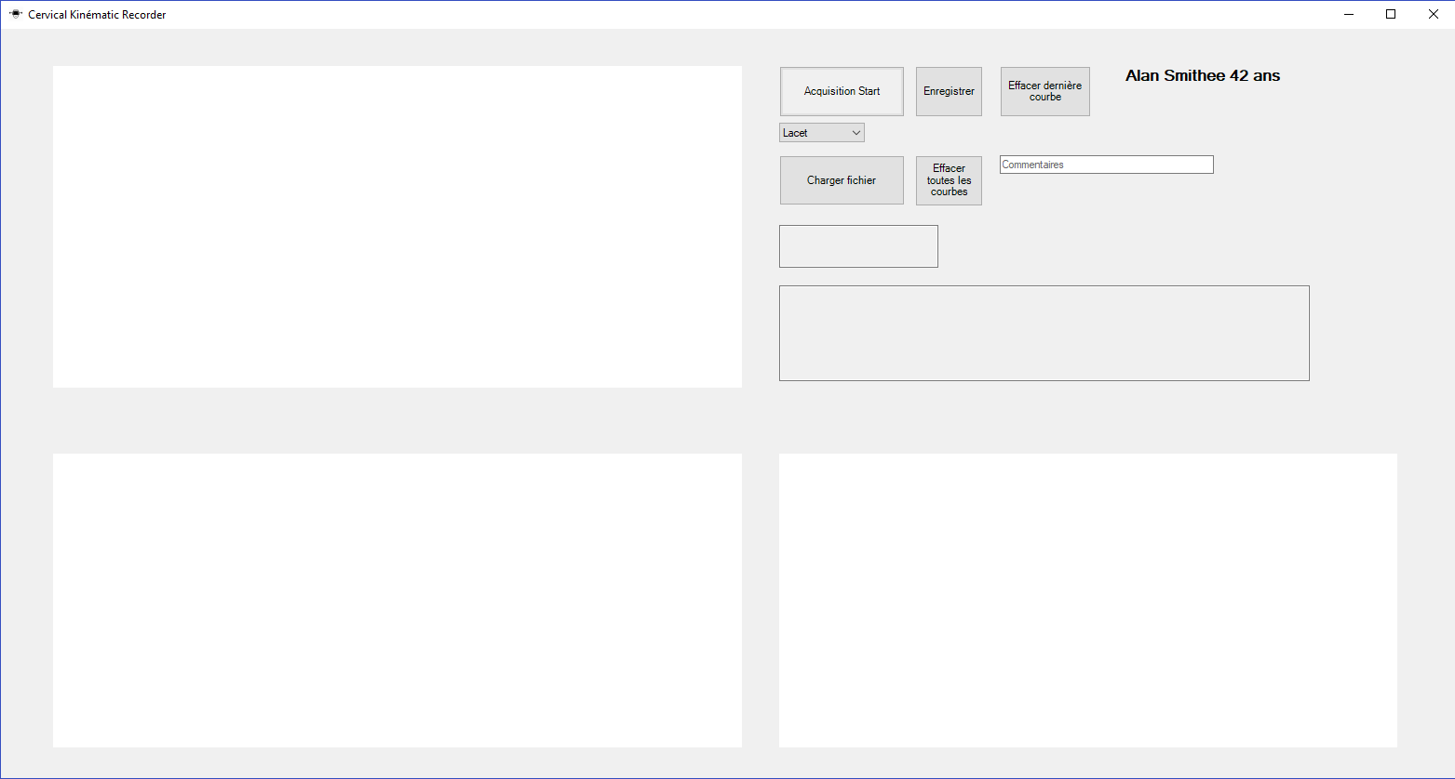
GUI comparison
Notes:
Flo

Slide 38
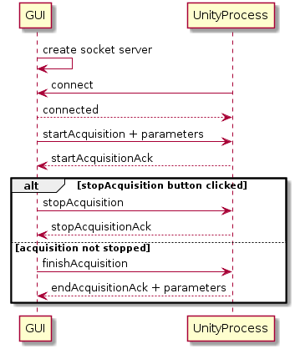
Socket communication
Allows to pass parameters and events between the two applications.
GUI creates the socket server and Unity connects to it
Notes:
DB GUI

Slide 39
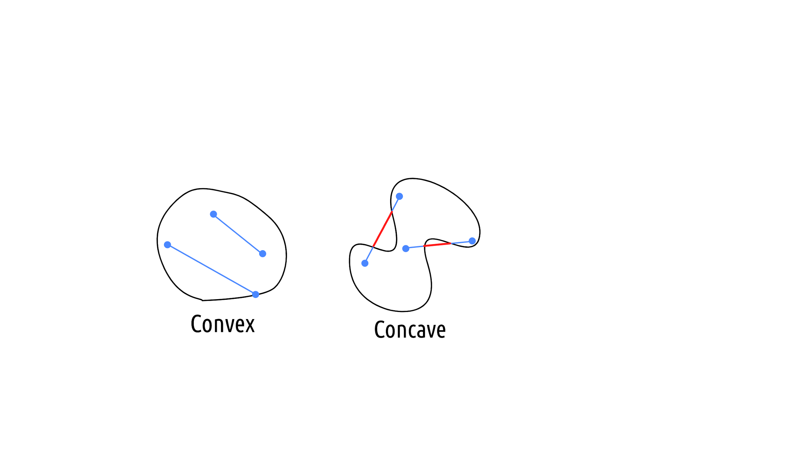
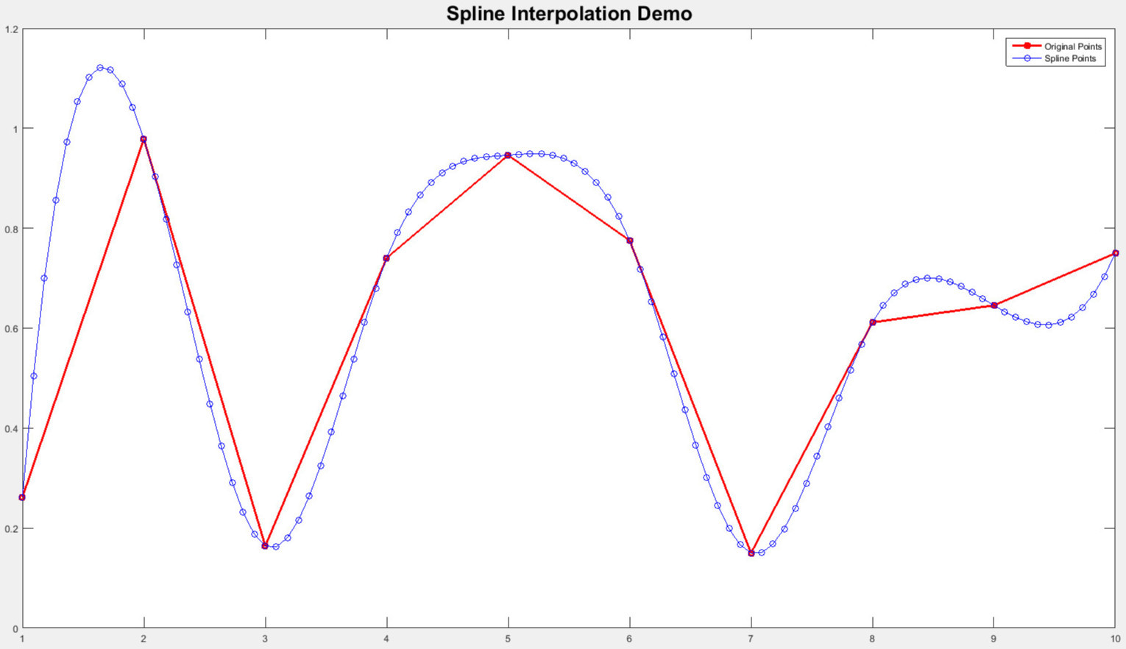
Idea: boundaries & variability
Hulls and Splines
Notes:
Build a “mean” concave hull with full data set
hull => general shape of the motion
concave fit better than convex BUT: an infinity
pts out of hull
Compute standard deviation of distance from curve to mean spline for every measure

Slide 40
Hulls and Splines: Analysis
Advantages:
Idea simple to understand, intuitive
Drawbacks:
Sensitive to the way of computing the hull
Hard to find a relevant quantity to determine whether the variability is too high
Possible improvements:
Change the way of computing the concave hull
Improve the way of computing the mean hull

Slide 41
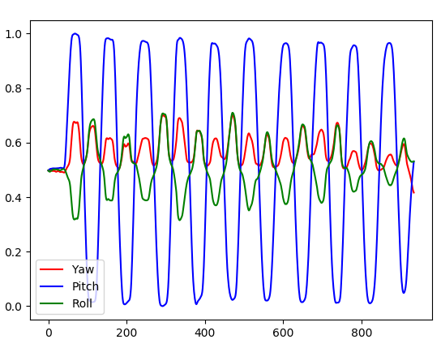
Signal Processing
Fast Fourier Transform (FFT)
Autocorrelation calculation
Wavelet transformation
Temporal profile analysis
Notes:
Luc

Slide 42
Signal Processing: Analysis
Advantages:
Huge amount of resources
Drawbacks:
FFT : Only temporal aspect
FFT and autocorrelation : Hard to exploit
Wavelet : Could not discern an ill profile
Improvements:
Exploit wavelet transform with a bigger dataset
Notes:
Luc

Slide 43
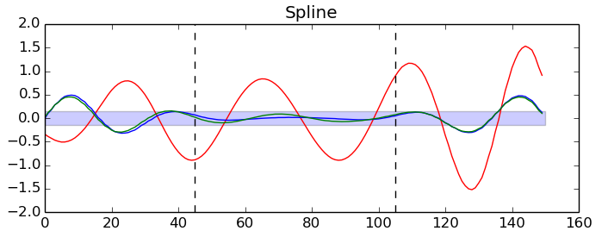
Wavelets and B-Splines
Interpolate angles with
B-Splines
Build Morlet Wavelets
Study amplitudes of
Pitch and Roll
Notes:
Quentin

Slide 44
Wavelets and B-Splines: Analysis
Advantages:
Simple to build
Wavelets take care of temporal and frequential aspect
Lot of wavelet types
Drawbacks:
Avoid overly/not enough smoothing
Border effect
Does it work ?
Improvements:
Find the best type of wavelets
Find the optimal parameters for smoothing
Find a threshold for Roll amplitude
Notes:
Quentin

Slide 45
Concave Hull Classification
Considering to use classification is natural given the problem
Use discrete concave hulls
Then classify with One Class SVM (outlier detection)
Notes:
explain classification
FX

Slide 46
Concave Hull Classification: Analysis
Advantages:
Machine learning can be very efficient
Very appropriate for this problem
Drawbacks:
Hard to find the optimal shape features
Need a big data set to build a model
Possible improvements:
Try other features
Acquire data
Use a neural network to extract features beforehand
Notes:
FX

Slide 47
Task Allocation
Two types of students in the group:
2 specialized in software development
3 specialized in applied mathematics
Able to separate the project between the two groups:
Data analysis done by the applied mathematics group
3D application and GUI done by the software group
The separation went naturally at the beginning of the project
Notes:
Quentin

Slide 48
Conclusion
7362
7
80%
Code lines
weeks of work
Project Achievements
Notes:
FX

Slide 49
Content in three columns
Content A
Content B
Content C
The marketing mix is a business tool used in marketing and by marketers, the marketing mix, originally can be used when determining a product or brand's offer, and is often associated with the four was
The marketing mix is a business tool used in marketing and by marketers, the marketing mix, originally can be used when determining a product or brand's offer, and is often associated with the four was
The marketing mix is a business tool used in marketing and by marketers, the marketing mix, originally can be used when determining a product or brand's offer, and is often associated with the four was

Slide 50
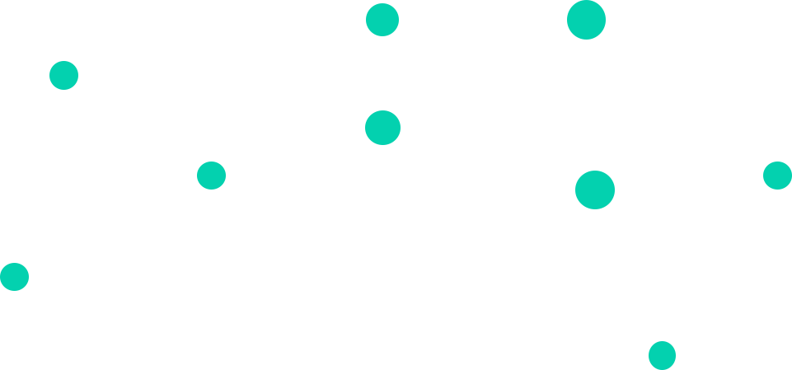

Great Break
Build better presentations in less time with our awesome presentations

Slide 51
Great Break
Use big pictures to engage your audience

Slide 52
Use Shapes to Show Values
Content A
Content B
Content C

Slide 53
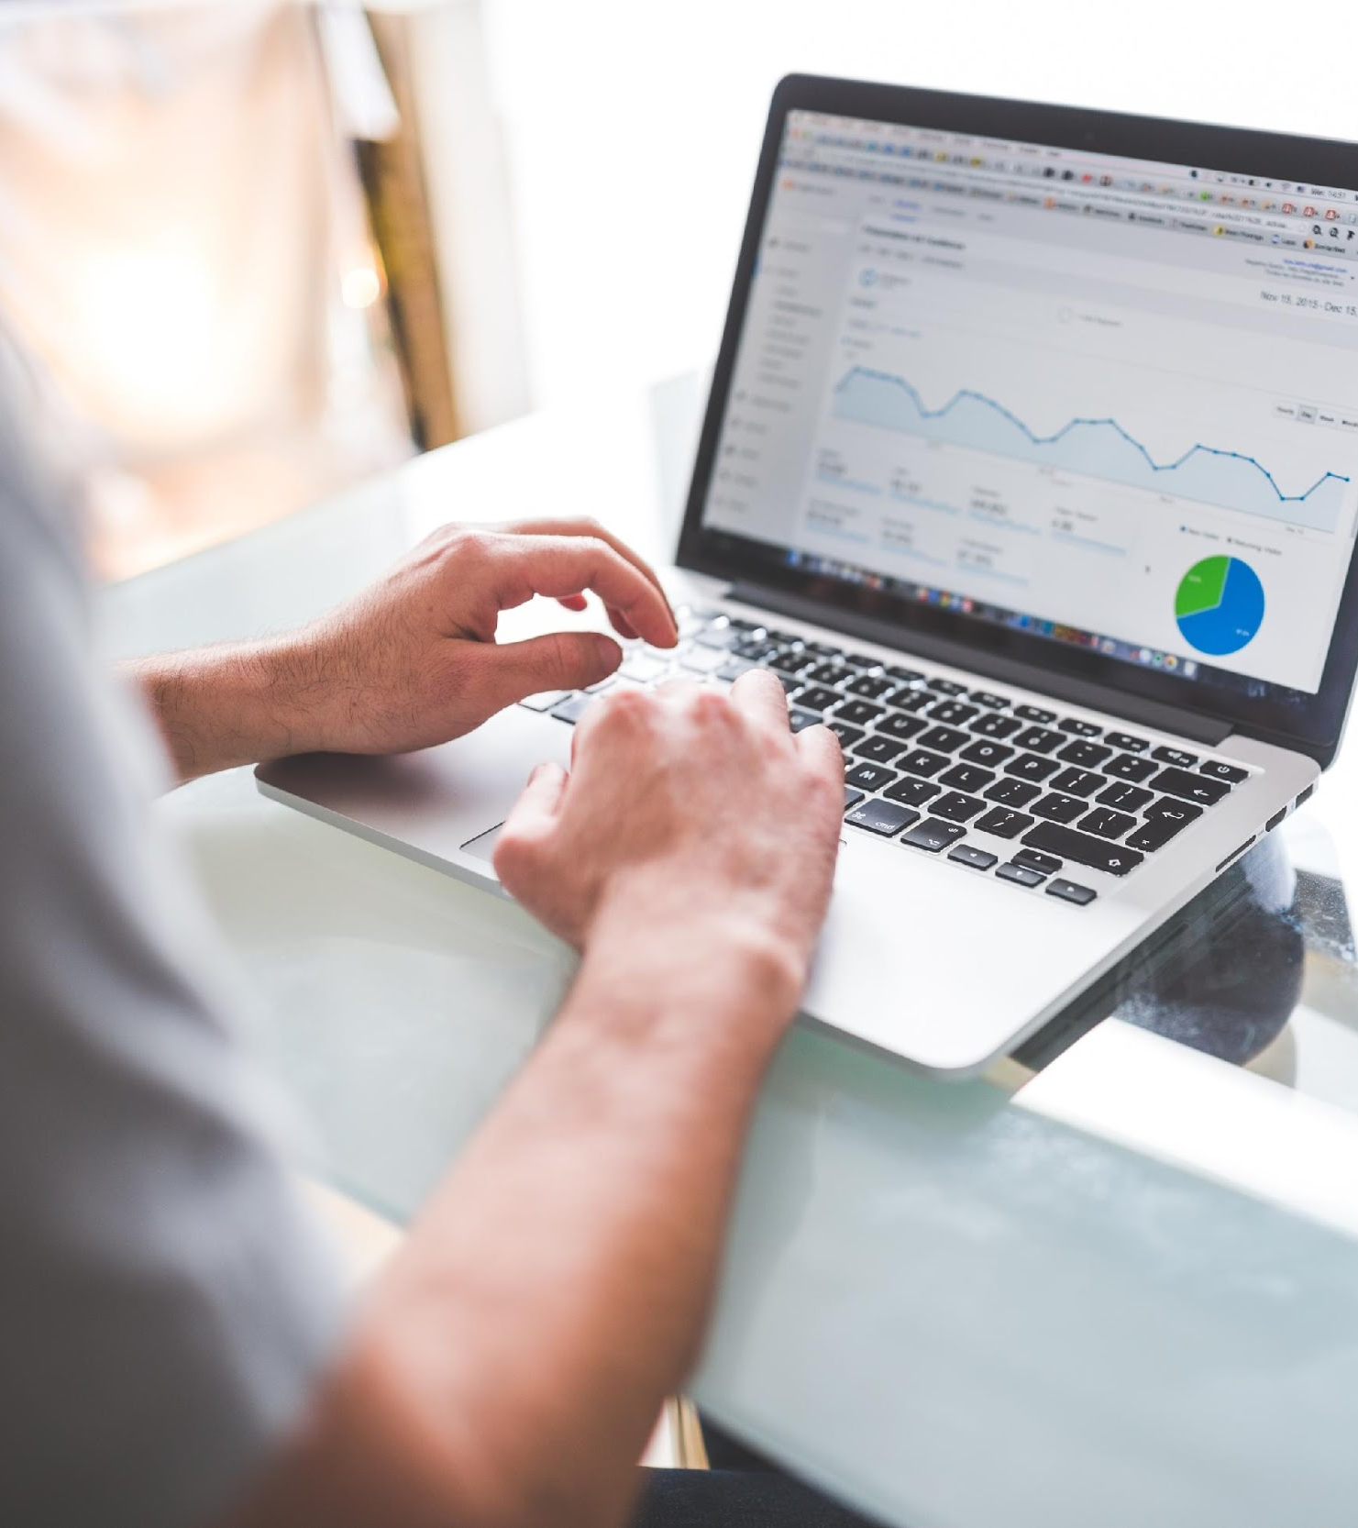
“A picture is worth a thousand words”

Slide 54
Use Tables To Compare Data
 | A | B | C | D
Content A | 100 | 200 | 400 | 800
Content B | $67,000 | $56,000 | $78,000 | $90,000
Content C | 4500 | 60000 | $8,000 | $20,000
Content D | 35000 | $400 | $600 | $1,200
Content E | $90 | $800 | $1,000 | $3,400

Slide 55

Creative Slides
The marketing mix is a business tool used in marketing and by marketers

Slide 56

Worldwide Map
Content A
The marketing mix is a business tool used in marketing and by marketers
Content B
The marketing mix is a business tool used in marketing and by marketers
Content C
The marketing mix is a business tool used in marketing and by marketers

Slide 57
Funny Facts
56,790,500
56,790,500
130%
Revenue from sales
Users around the world
Project Achievements

Slide 58
Step 03
The Process
The marketing mix is a business tool used in companies and by marketers
Step 01
Step 02

Slide 59
Our Services
Content A
Content B
Content C
The marketing mix is a business tool used in marketing can be used
The marketing mix is a business tool used in marketing can be used
The marketing mix is a business tool used in marketing can be used
Content D
Content E
Content F
The marketing mix is a business tool used in marketing can be used
The marketing mix is a business tool used in marketing can be used
The marketing mix is a business tool used in marketing can be used

Slide 60
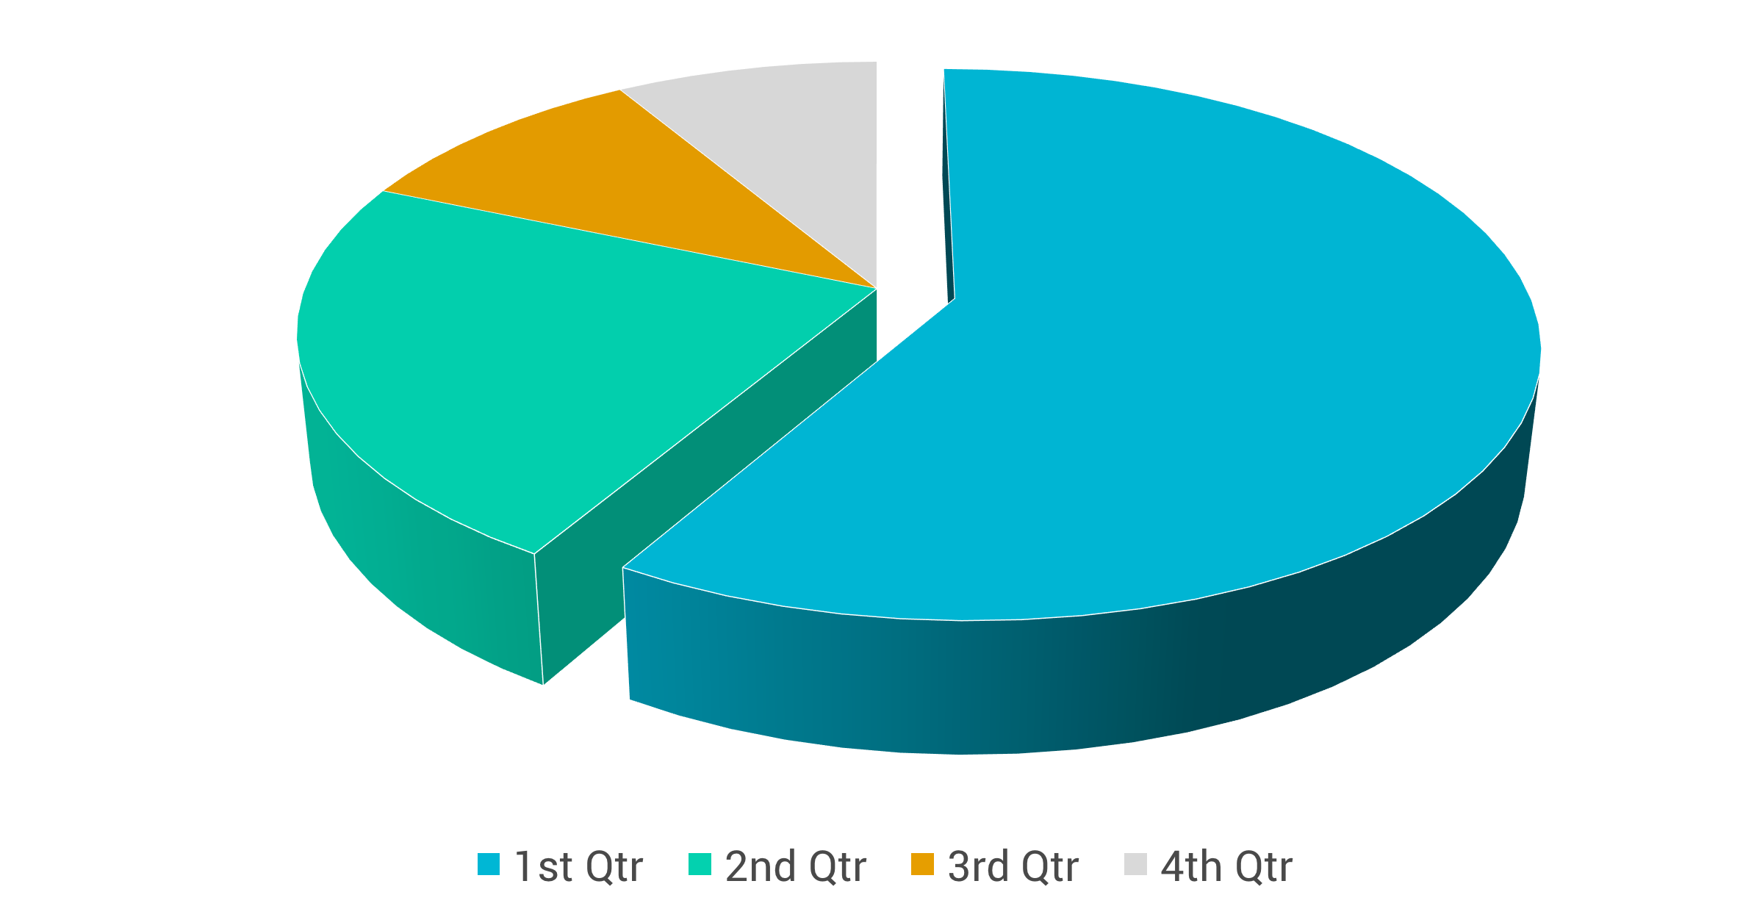
Use Charts to Present Your Data

Slide 61
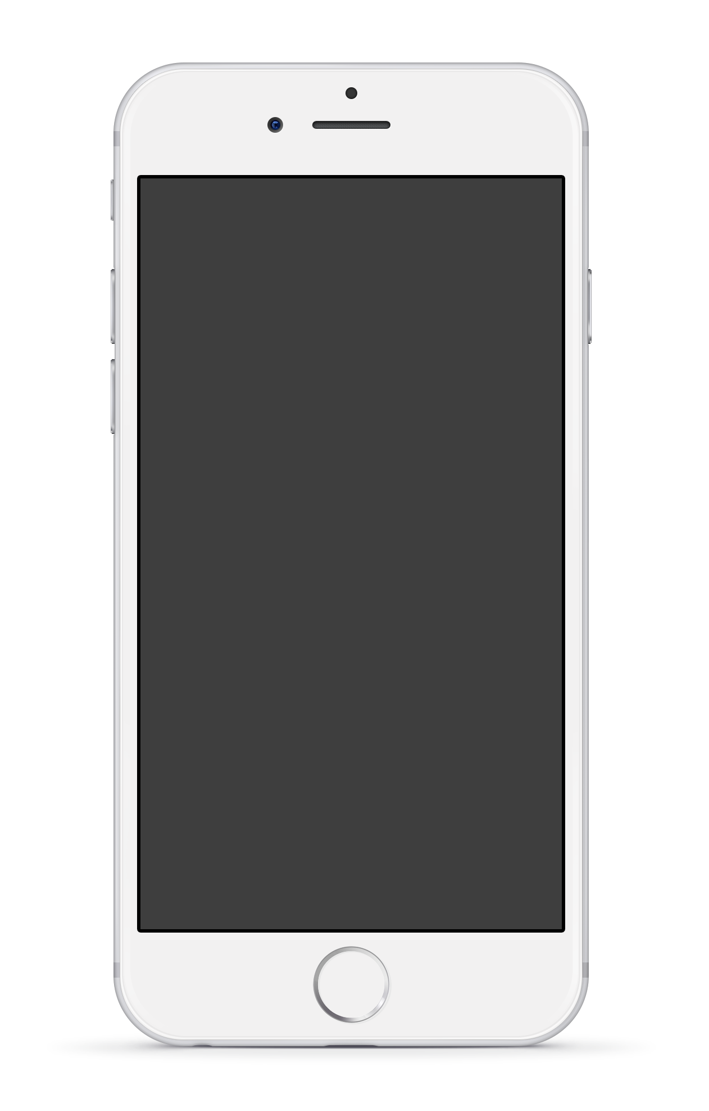
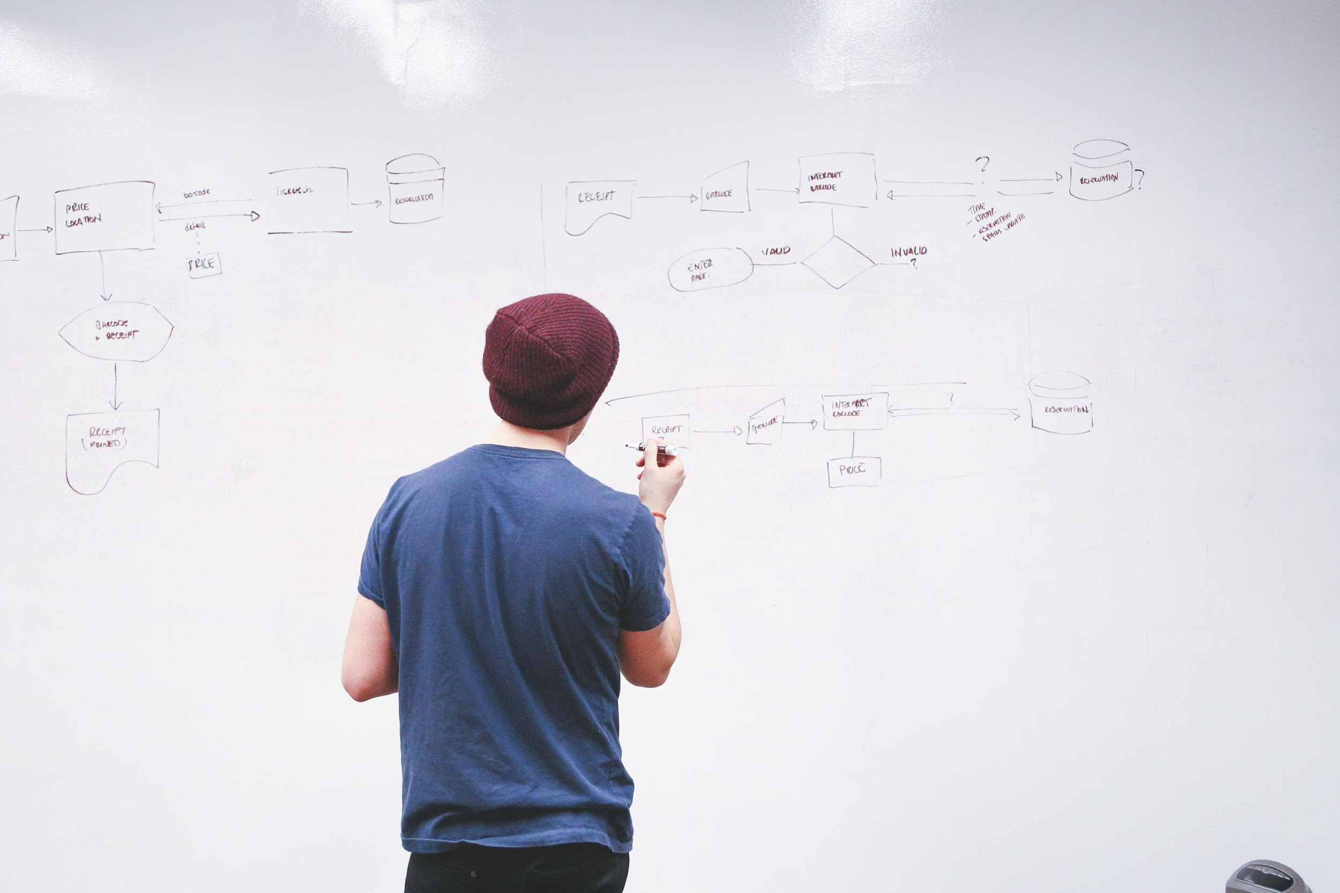
App Features
Content A
The marketing mix is a business tool used in marketing can be used
Content B
The marketing mix is a business tool used in marketing can be used

Slide 62
Laptop Features
Content A
The marketing mix is a business tool used in marketing can be used
Content B
The marketing mix is a business tool used in marketing can be used

Slide 63

Website Optimization
Content A
The marketing mix is a business tool used in marketing can be used
Content B
The marketing mix is a business tool used in marketing can be used

Slide 64
Contact US
123 Barker,
Philadelphia
United Sates 94044
Phone: 123 – 001-3550-080
Pbox: Mkl4532
Email: Myname@domain.Com

Slide 65
“
“A person who never made a mistake never tried anything new”

Slide 66
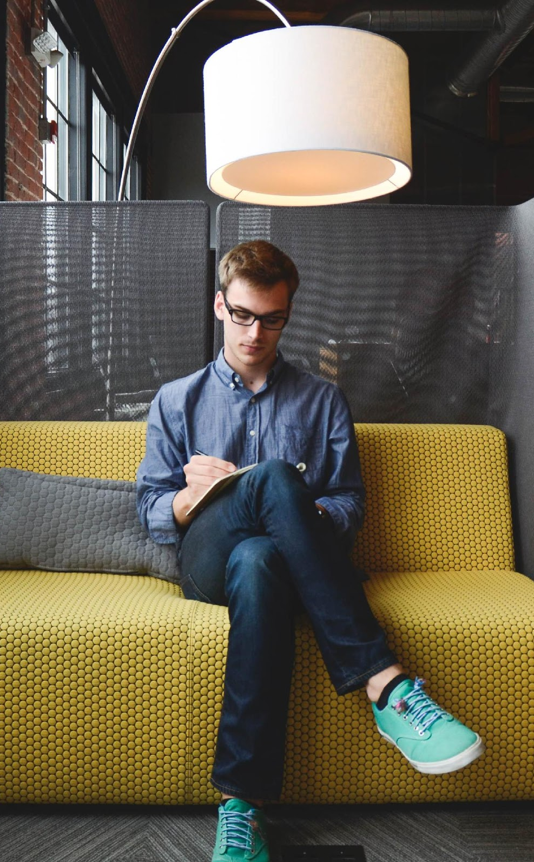
Content in two columns
Content A
Content B
The marketing mix is a business tool used in marketing and by marketers, the marketing mix, originally can be used when determining a product or brand's offer, and is often associated with the four was
The marketing mix is a business tool used in marketing and by marketers, the marketing mix, originally can be used when determining a product or brand's offer, and is often associated with the four was

Slide 67
Vector Icons

Slide 68
ELECTRONICS
MISCELLANEOUS

Slide 69
E-COMMERCE
WEB

Slide 70
ARROWS
LOCATION
WEATHER

Slide 71
Fully Editable Icon Sets : A
You can Resize without losing quality
You can Change Fill Color &
Line Color
FREE
PPT TEMPLATES
www.allppt.com

Slide 72
Fully Editable Icon Sets : B
You can Resize without losing quality
You can Change Fill Color &
Line Color
FREE
PPT TEMPLATES
www.allppt.com

Slide 73
Fully Editable Icon Sets : C
You can Resize without losing quality
You can Change Fill Color &
Line Color
FREE
PPT TEMPLATES
www.allppt.com

